Slide 1

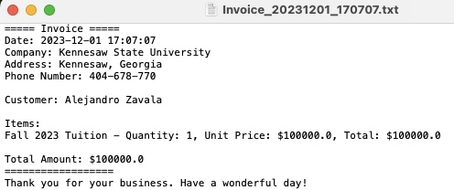

Invoice creator by Alejandro Zavala
This project is to create a program that can create invoices for companies after making a sale. Such as in the screenshot beside.
https://github.com/ksu-is/InvoiceCreator

